Slide 1

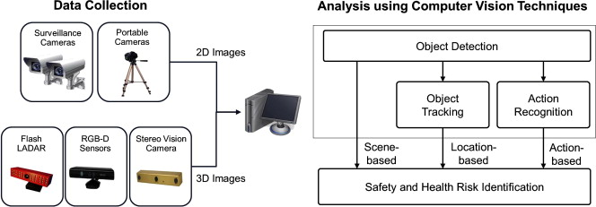
SaftyAware
Computer Vision for Safety
Your
Logo
Merve Yanik Mechanical Engineering
Zonghai Yang Civil Engineering
16/01/2024
Computer Vision for Safety
Design Driven Project

Slide 2
Your
Logo
Problem Statement
Notes:
What is it that we are doing?

Slide 3

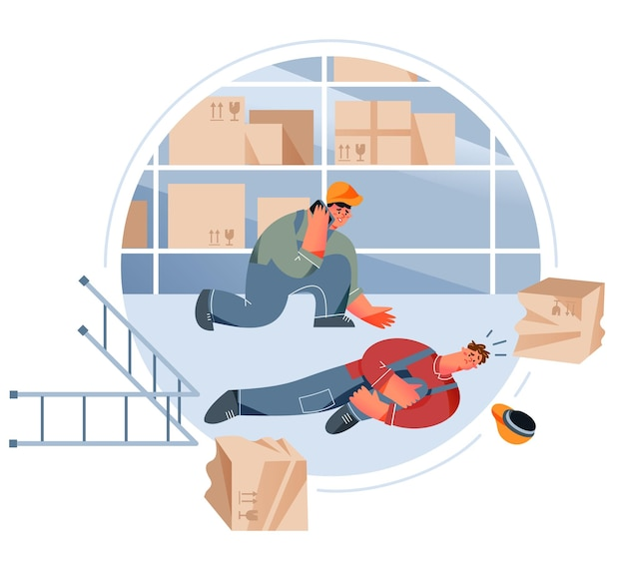

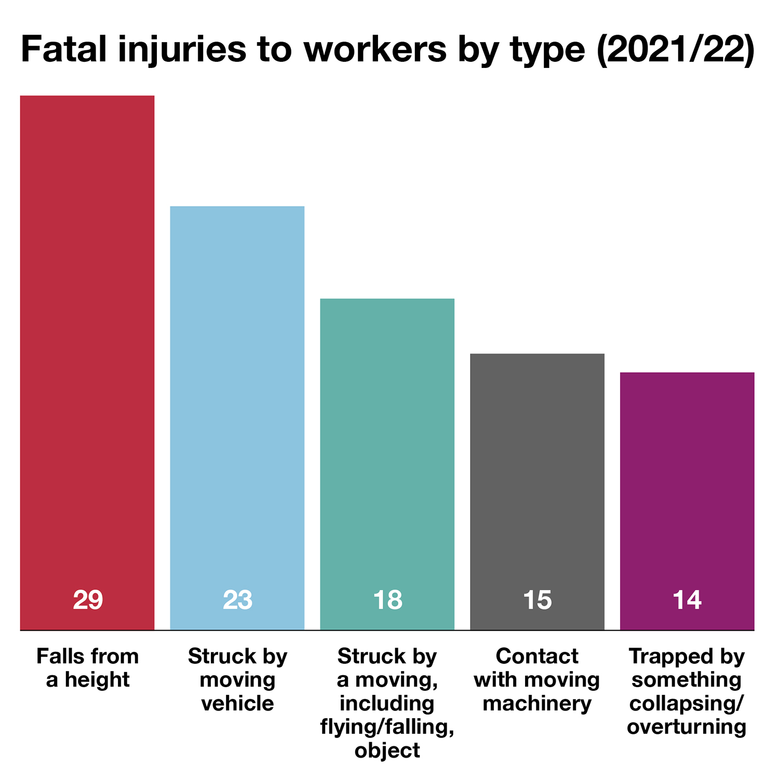

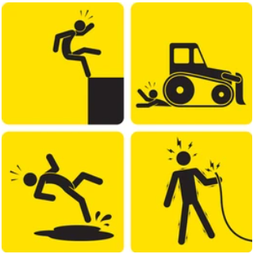
Problem Statement
Accident
Crisis Project Timing
Lost Cost
Fig1: Injuries in Europe construction

Slide 4
Project Goal
Notes:
What is it that we are doing?

Slide 5
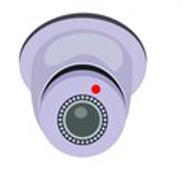
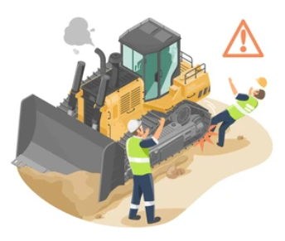


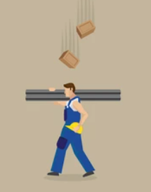

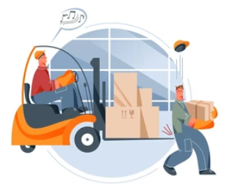

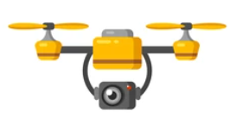
Goal: Reducing Accidents in Construction Site by Using CV
Detecting Risk
Analyse Output
*CV, Management Control
Solve Problem
*Timely Alert

Slide 6
Concept
Notes:
What is it that we are doing?

Slide 7
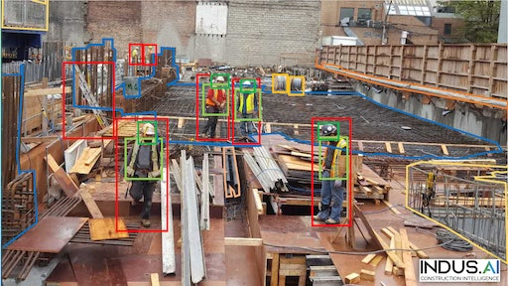
Concept
Why Computer Vision?
Image Classification and Recognition:
It identifies installation, materials, equipment, and personnel to ensure workplace safety.
Object Detection and Tracking：
Computer vision detects specific targets such as people, vehicles, falling objects, and enables real-time alert on construction sites.
Privacy Protection:
Computer vision can blur or pixelate individuals in images to protect their privacy, a crucial aspect of construction site surveillance.
Fig4: Person and equipment detection by CV

Slide 8
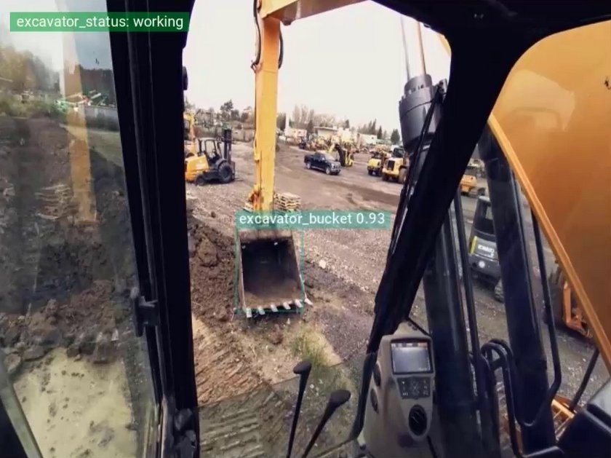
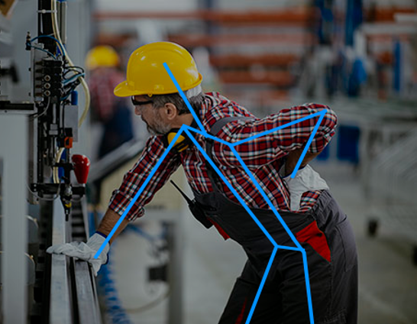
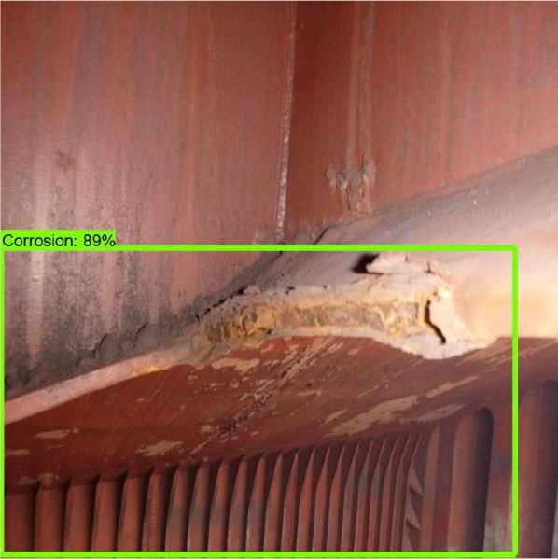
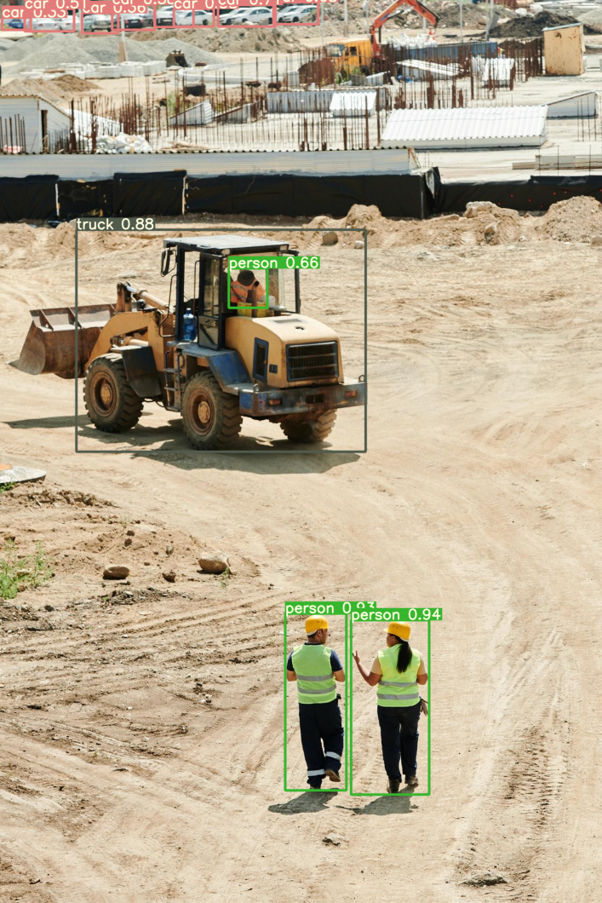
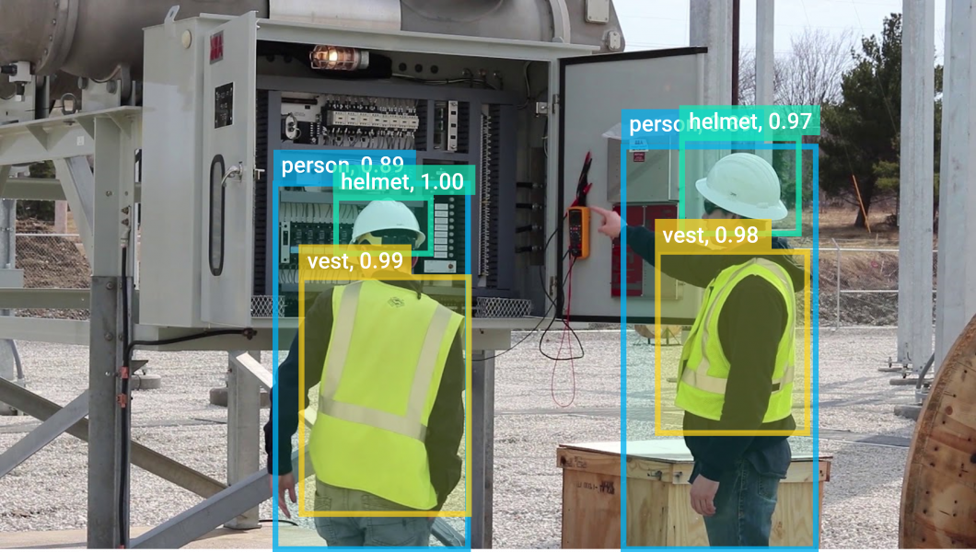
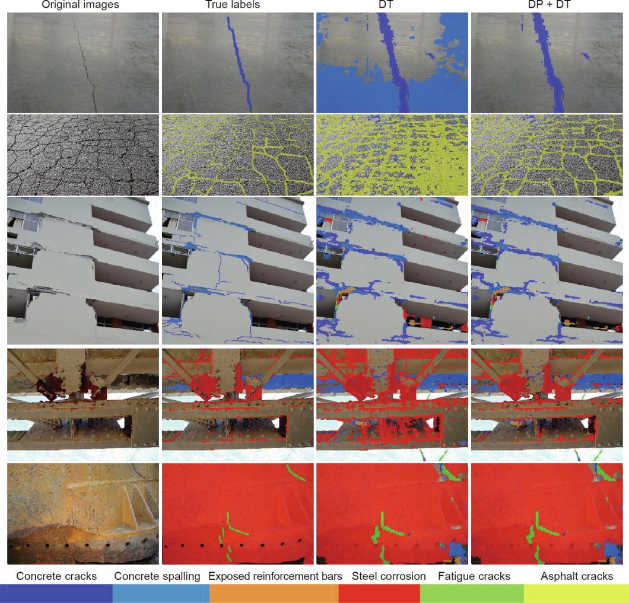
Applications of Computer Vision in Construction
Process optimization
Human pose estimation
Corrosion detection
Detection and tracking
PPE detection
References: https://viso.ai/applications/computer-vision-in-construction/
Detection of structural defects

Slide 9
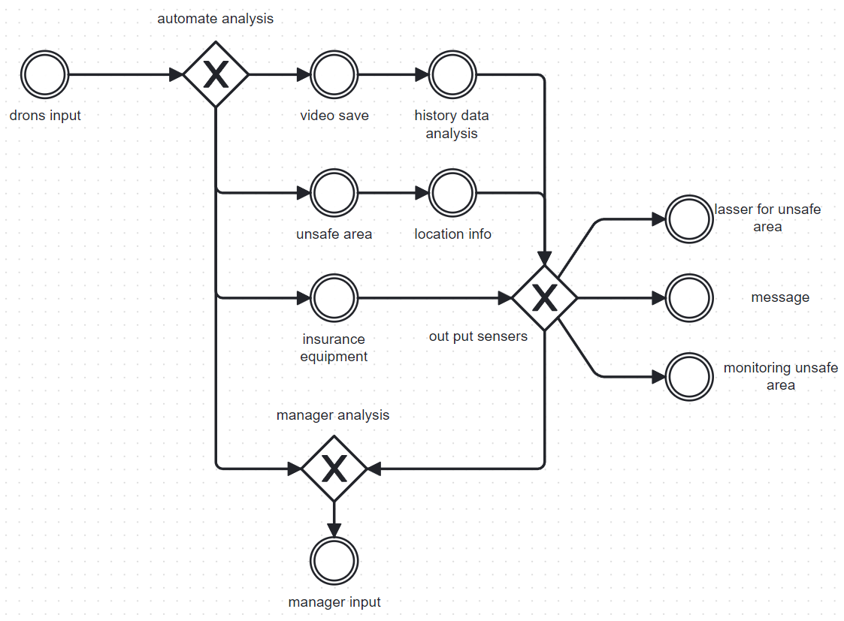
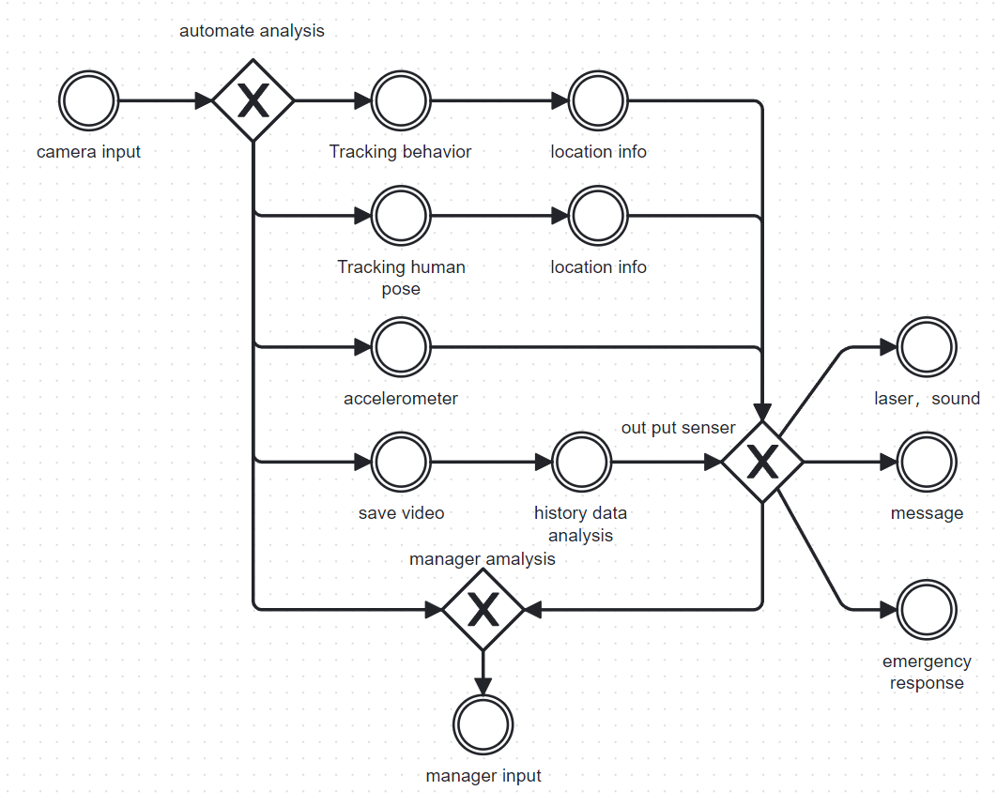
Our Concept
Drones Workflow
Cameras Workflow

Slide 10
Open-source &
Hardware components
Your
Logo
Notes:
What is it that we are doing?

Slide 11

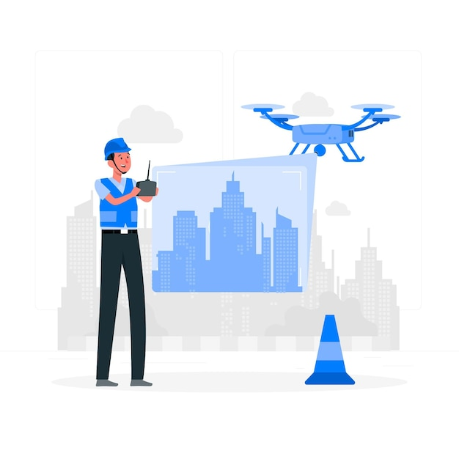
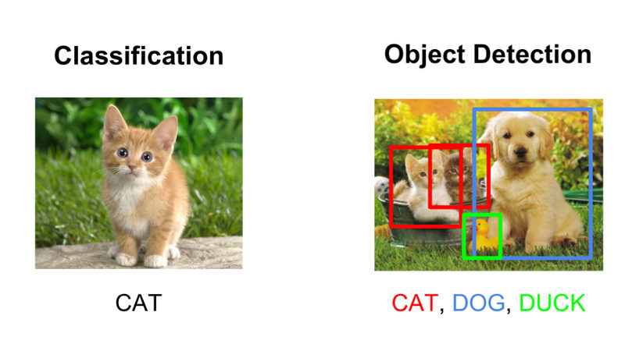

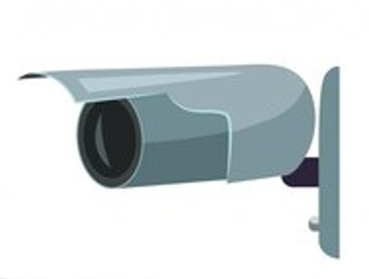
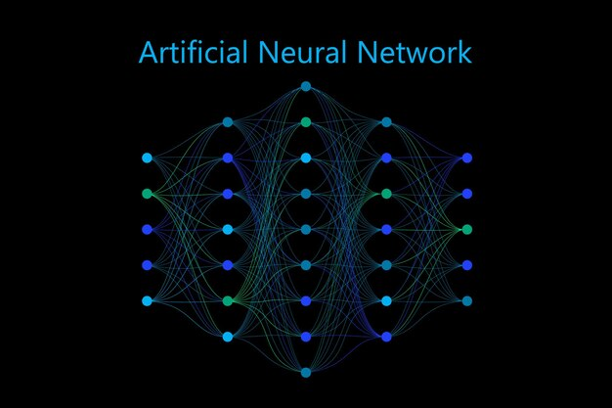
Implementation
Sending Timely Alert
Monitoring, Collect Data
Drones & Cameras
Computer Vision
CNN, Object Detection
Unsafety
Transfer data
Safety
All is well!
Observation
Analyse
Make Action

Slide 12
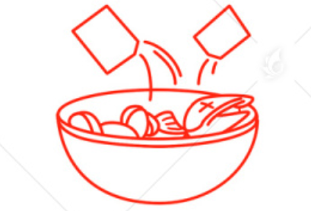

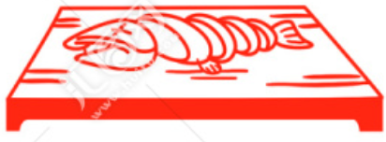
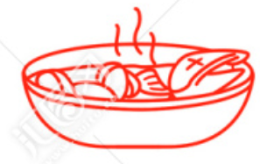
Open-source
Sources:
Get open-source assets
Integrate Functions
Train and adjust model
Github:
Yolov7 and dataset
https://github.com/WongKinYiu/yolov7
https://github.com/RizwanMunawar/yolov7-pose-estimation
https://universe.roboflow.com/mmai894college/yolov7-for-ppe-detection/dataset/9
Paper research：
Edge Deep Learning and Computer Vision-Based Physical Distance and Face Mask Detection System Using Jetson Xavior NX
YOLOv7: Trainable bag-of-freebies sets new state-of-the-art for real-time object detectors
Realtime Multi-Person 2D Pose Estimation using Part Affinity Fields
Package Software

Slide 13
Your
Logo
Outlook
Notes:
What is it that we are doing?

Slide 14
What else can be improved?
Crack & Corrosion detection
Machinery status observation
Counting person and machinery in construction site to estimate the volume of the area
Training more complex model(e.g. with more key-points)
Setup interface and more output options for the user
….

Slide 15
Any Questions ?
Notes:
What is it that we are doing?

Slide 16
References
Fig1:https://projectsafetyjournal.com/construction-deaths-drop-25
Fig2:Numan Khan, Syed Farhan Alam Zaidi, Jaehun Yang, Construction Work-Stage-Based Rule Compliance Monitoring Framework Using Computer Vision (CV) Technology
Fig3: Numan Khan, Syed Farhan Alam Zaidi, Jaehun Yang, Construction Work-Stage-Based Rule Compliance Monitoring Framework Using Computer Vision (CV) Technology
Fig4: Person detection by CV and Drones: https://viso.ai/applications/computer-vision-in-construction/
PPE-Video: https://www.computervision.zone/topic/demo-videos/
Pos-detect-video: Film name : ‘‘A Time for Consequences’’

Slide 17
Thanks for your attention
Notes:
What is it that we are doing?

